Slide 1

DAB Temperature testing after 2 min. out of the environment chamber at -35 and 85

Slide 2
Content
Object
Instruments and settings
Result & analysis
Conclusion

Slide 3
Object
Constant temperature, an key assumption in DAB deployment simulation, has obvious conservative and deviation for cover strength. Therefore, the assumption should be considered cautiously.
Temperature testing has been conducted for analyzing the temperature distribution in four DAB modules. These DAB modules have different structures and materials, whose influence should also be considered.

Slide 4
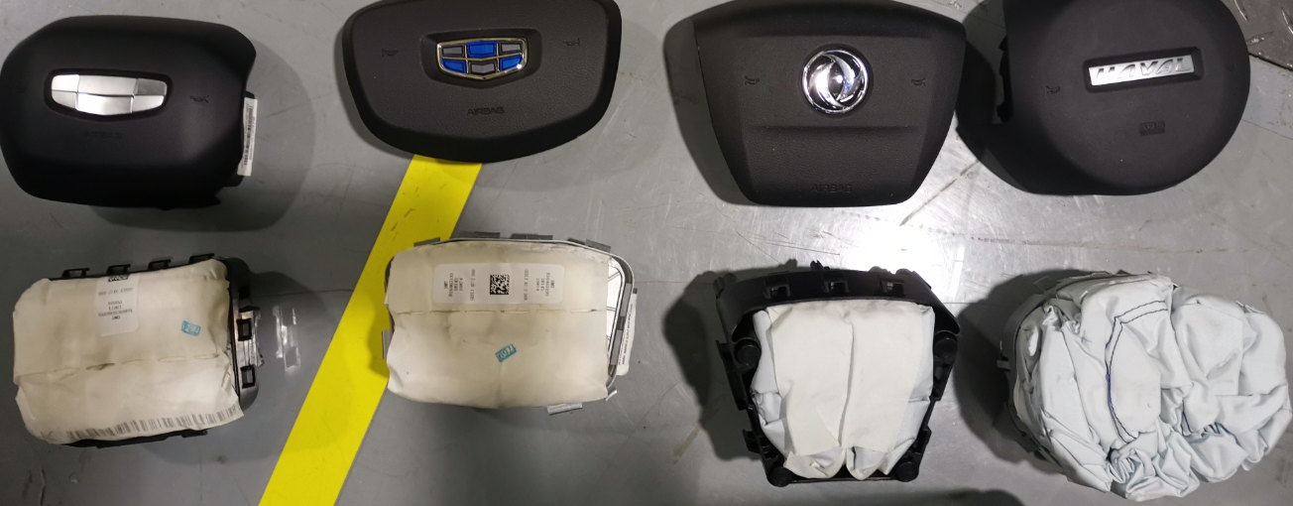
DAB Modules
SX12
KC-2
G95
P3011

Slide 5
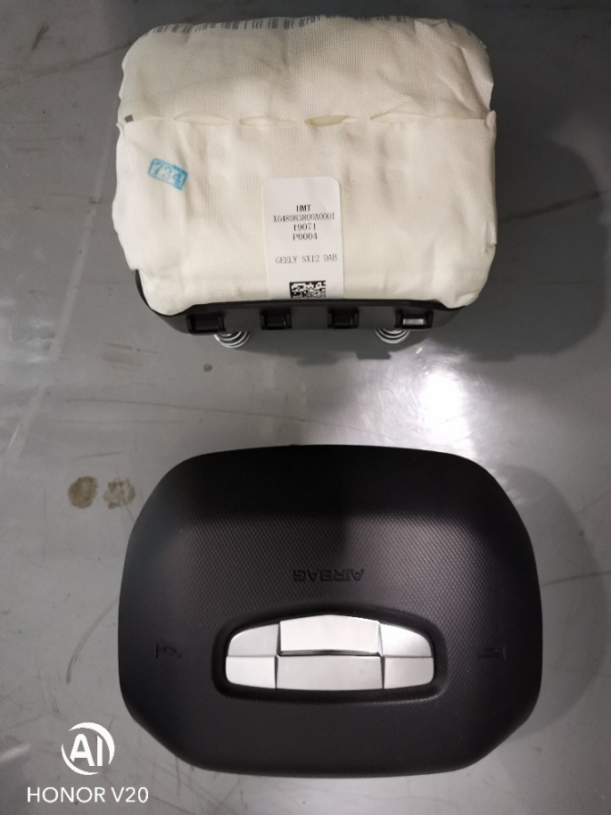
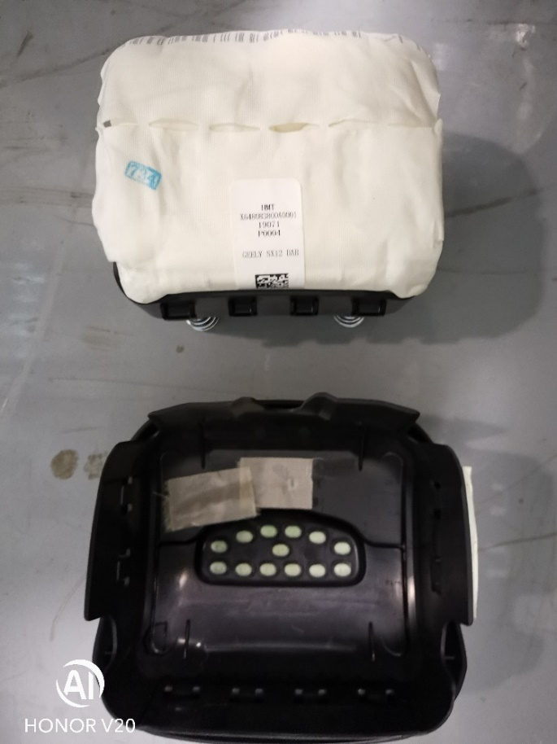
DAB Module – SX12 Cover:TES2403 Housing: PG8 PA6 40% fiber Design type: Floating module PE: Maggie Meng

Slide 6
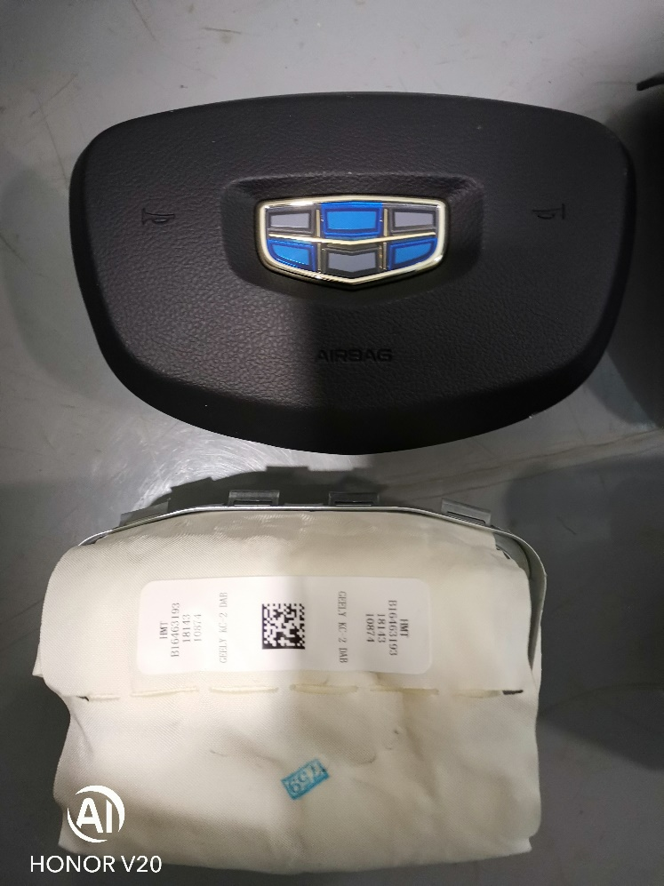
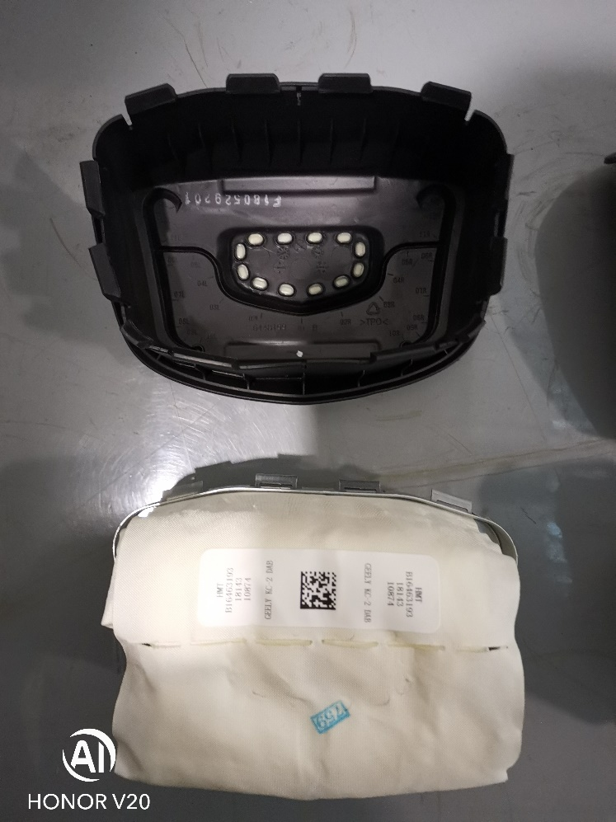
DAB Module – KC-2 Cover:TES2403 Housing: Steel Design type: Floating module PE: Haojie Gao

Slide 7
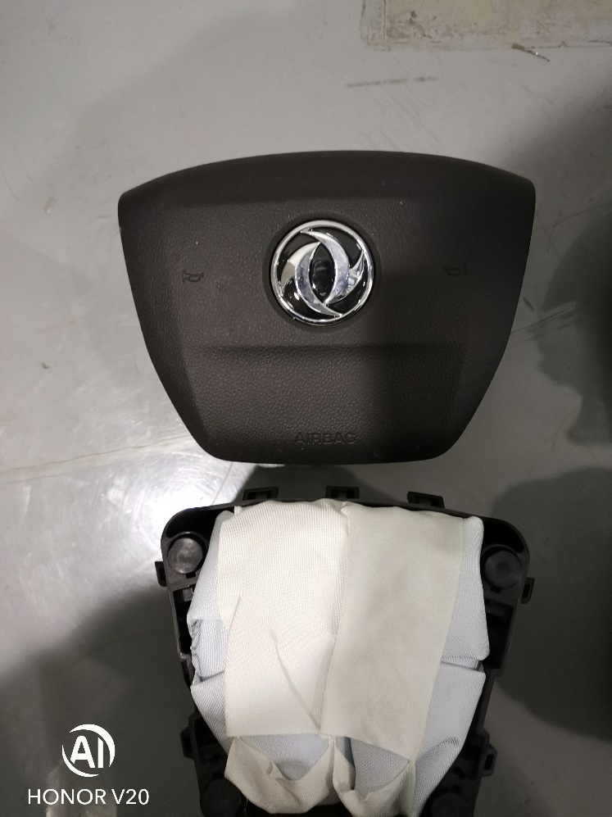
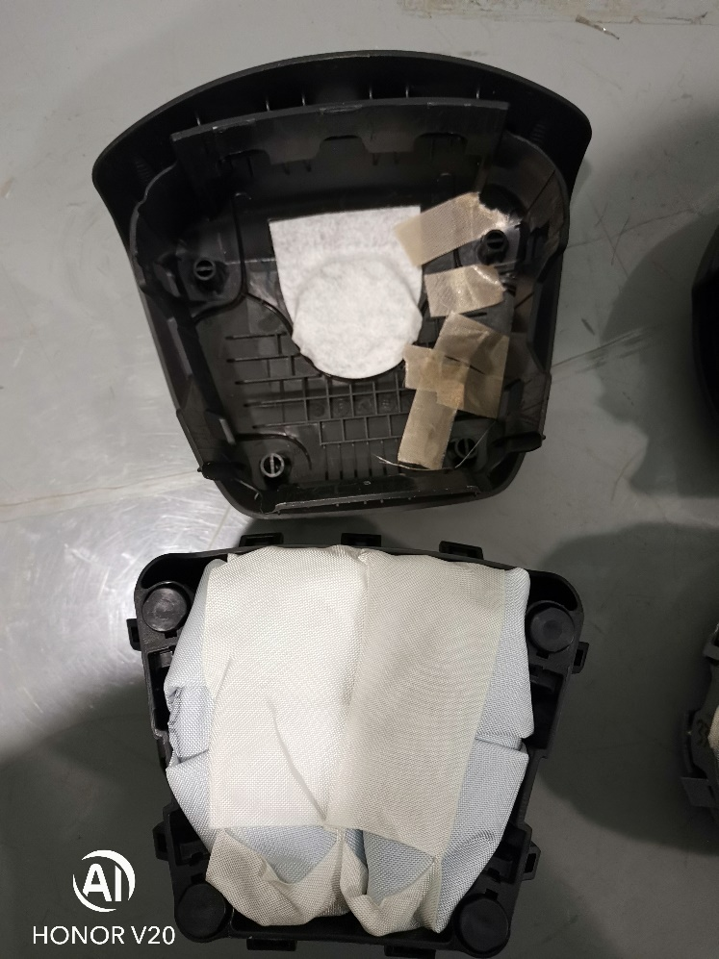
DAB Module – G95 Housing: PG8 PA6 40% fiber Design type: Floating cover PE: Jolay Zhou

Slide 8
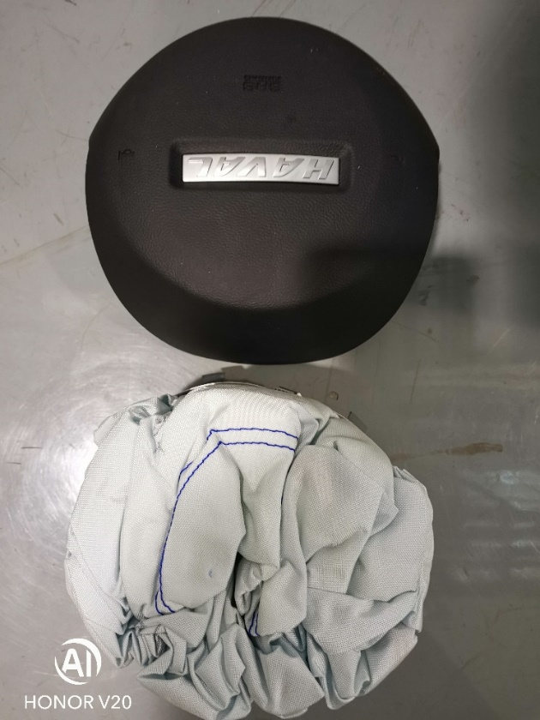
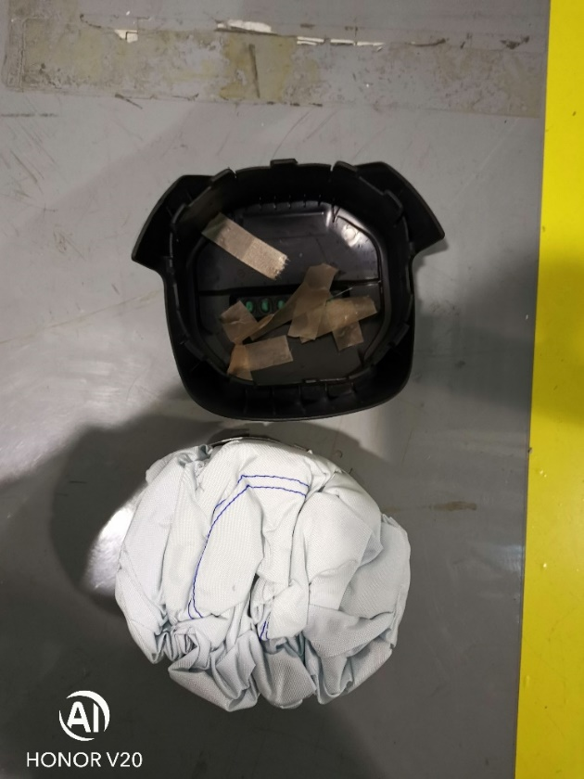
DAB Module – P3011 Cover:TA1081B Housing: Steel Design type: Floating module PE: Kaixuan Zeng

Slide 9
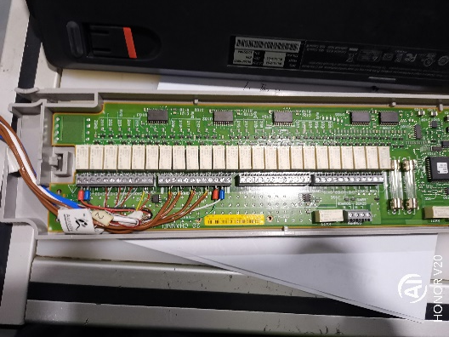
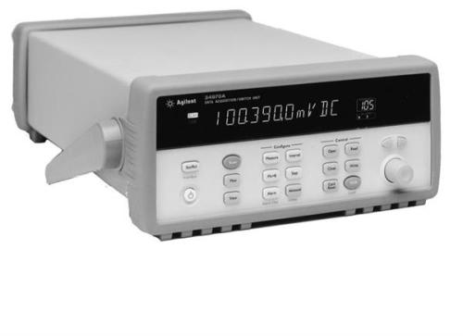
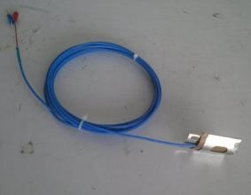
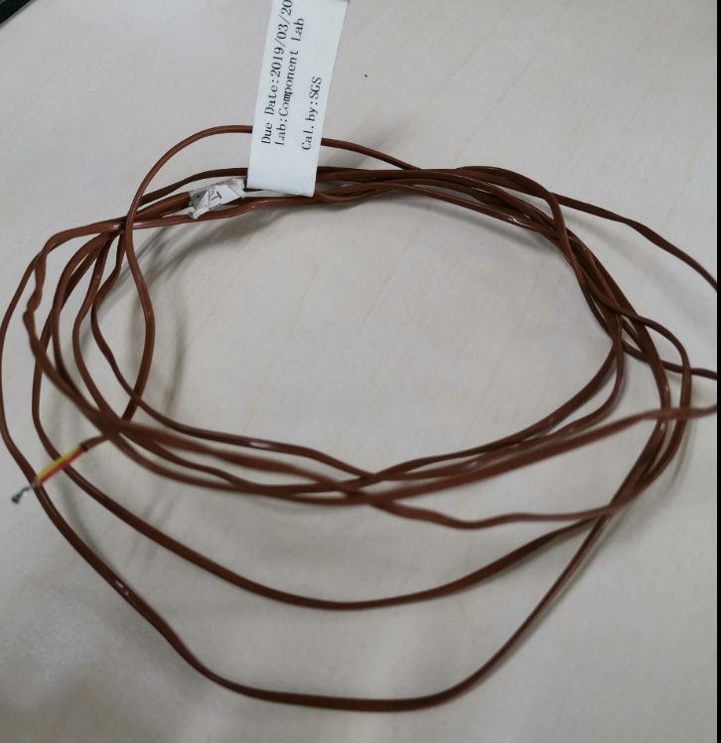
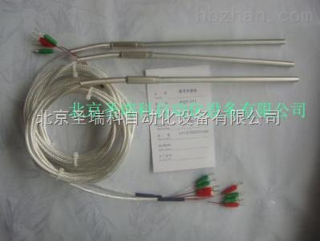
Instruments and settings
Digital acquisition instrument
Agilent Digital Acquisition
Temperature sensor
4 line armoring thermal resistance
Provider: Kecheng Cai
Num.: 1
Channel: 101
K thermal couple (plate)
Provider: Qihe Xiao
Num.: 3
Channel: 103,104,105
K thermal couple (needle)
Provider: P Yigang Sun
Num.: 5
Channel: 106,107,108,109,110

Slide 10
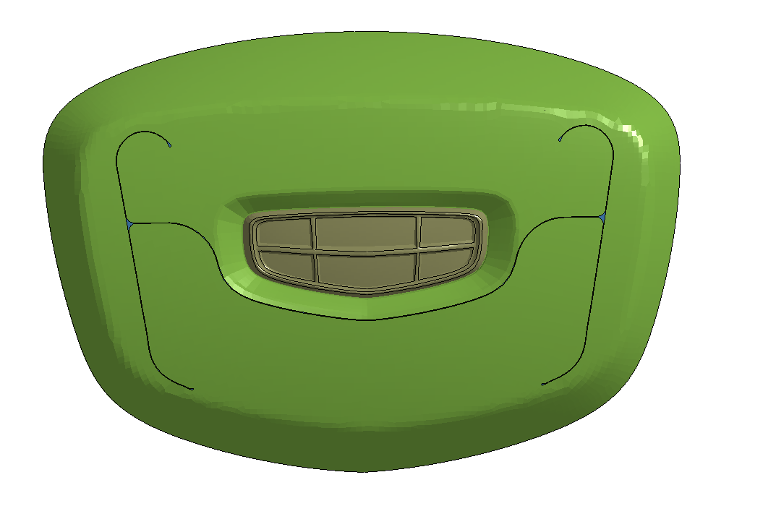
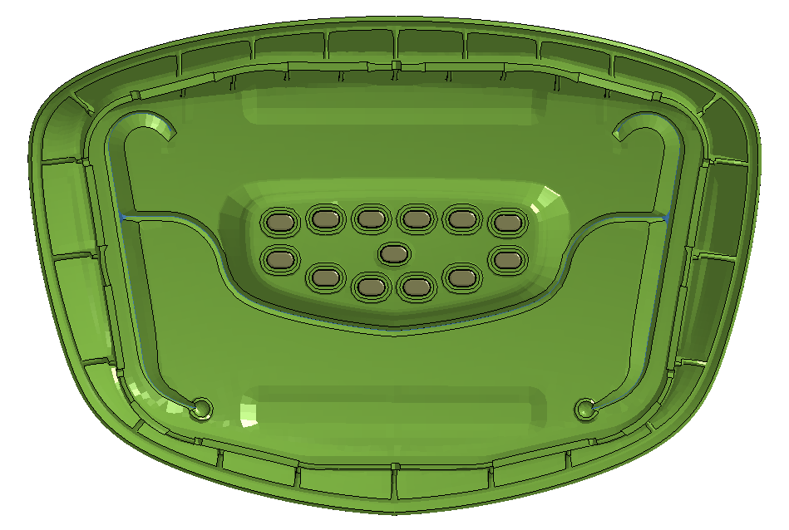
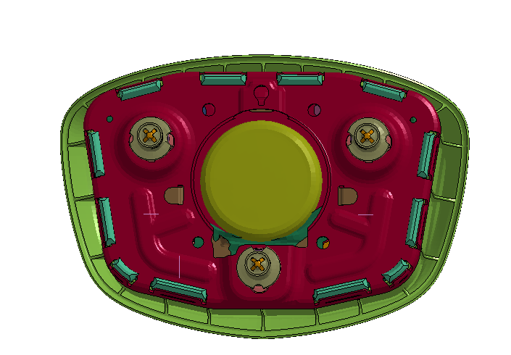
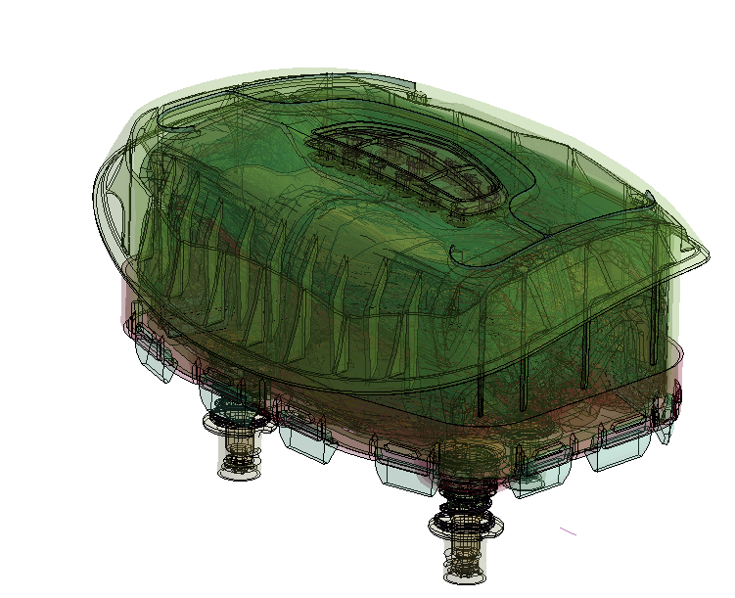
Instruments and settings The location of the temperature sensors, testing environment temperature 26~29 ℃, and test time is 2 min.
110
103
105
108
104
Channal | Location
101 | DAB center(TR)
103 | Tearline Root(inner)
104 | Cover center(inner)
105 | Cover center(outer)
106 | DAB center(TC)
107 | Inflator Bottom (outer)
108 | Tearline w/o emblem (inner)
109 | Infltor bottom(inner)
110 | Tearline w emblem root(outer)
107
101 & 106
109
Note: The outer thermal couples (105,110) separated from cover in 85℃.

Slide 11
Result & analysis SX12
Note: Five thermal couples (106,107,108,109,110) are not used.

Slide 12
Result & analysis KC-2

Slide 13
Result & analysis G95

Slide 14
Result & analysis P3011

Slide 15
Result & analysis
Channel | Location | SX12 |  |  |  |  |  | KC-2 |  |  |  |  |  | Dongfeng G95 |  |  |  |  |  | Changcheng P3011
 |  | 85℃ |  |  | -35℃ |  |  | 85℃ |  |  | -35℃ |  |  | 85℃ |  |  | -35℃ |  |  | 85℃ |  |  | -35℃
 |  | 0s | 120s | Diff. | 0s | 120s | Diff. | 0s | 120s | Diff. | 0s | 120s | Diff. | 0s | 120s | Diff. | 0s | 120s | Diff. | 0s | 120s | Diff. | 0s | 120s | Diff.
101 | DAB center | 82.814 | 82.715 | 0.099 | -33.552 | -33.223 | -0.329 | 82.6 | 82.166 | 0.434 | -33.83 | -32.649 | -1.181 | 82.501 | 82.073 | 0.428 | -34.309 | -33.542 | -0.767 | 82.143 | 82.013 | 0.13 | -33.388 | -33.085 | -0.303
103 | Tearline root (inner) | 82.238 | 76.61 | 5.628 | -30.643 | -8.695 | -21.948 | 81.851 | 71.268 | 10.583 | -31.328 | -13.551 | -17.777 | 82.218 | 68.999 | 13.219 | -31.125 | -7.976 | -23.149 | 81.645 | 73.805 | 7.84 | -29.107 | -19.584 | -9.523
104 | Cover center(inner) | 81.871 | 70.434 | 11.437 | -30.494 | -13.737 | -16.757 | 81.429 | 75.17 | 6.259 | -30.634 | -17.775 | -12.859 | 81.682 | 79.697 | 1.985 | -30.878 | -26.164 | -4.714 | 81.337 | 72.655 | 8.682 | -29.706 | -19.108 | -10.598
105 | Cover center(outer) | 81.755 | 59.6 | 22.155 | -30.286 | -5.246 | -25.04 | 81.548 | 59.446 | 22.102 | -30.703 | -1.297 | -29.406 | 82.363 | 26.231 | 56.132 | -30.015 | -1.594 | -28.421 | 81.623 | 57.535 | 24.088 | -29.373 | -5.745 | -23.628
106 | DAB Center(TC) |  | \ |  |  | \ |  | 81.649 | 81.575 | 0.074 | -30.705 | -30.515 | -0.19 | 81.407 | 80.561 | 0.846 | -30.919 | -29.589 | -1.33 | 81.25 | 81.125 | 0.125 | -30.168 | -29.991 | -0.177
107 | Inflator Bottom (outer) |  | \ |  |  | \ |  | 82.091 | 71.068 | 11.023 | -31.023 | -15.103 | -15.92 | 81.961 | 74.194 | 7.767 | -31.19 | -19.811 | -11.379 | 81.959 | 77.243 | 4.716 | -30.469 | -23.668 | -6.801
108 | Tearline w/o emblem (inner) |  | \ |  |  | \ |  | 81.68 | 71.935 | 9.745 | -30.456 | -16.89 | -13.566 | 82.001 | 78.147 | 3.854 | -30.868 | -24.235 | -6.633 | 81.321 | 74.575 | 6.746 | -28.771 | -20.211 | -8.56
109 | Infltor bottom(inner) |  | \ |  |  | \ |  | 82.328 | 77.156 | 5.172 | -31.185 | -21.508 | -9.677 | 81.84 | 79.115 | 2.725 | -31.086 | -26.786 | -4.3 | 82.392 | 67.321 | 15.071 | -30.614 | -11.947 | -18.667
110 | Tearline w emblem root(outer)） |  | \ |  |  | \ |  | 81.958 | 58.537 | 23.421 | -30.227 | -1.398 | -28.829 | 82.803 | 28.134 | 54.669 | -30.504 | 0.26 | -30.764 | 81.858 | 62.81 | 19.048 | -28.773 | -6.32 | -22.453

Slide 16

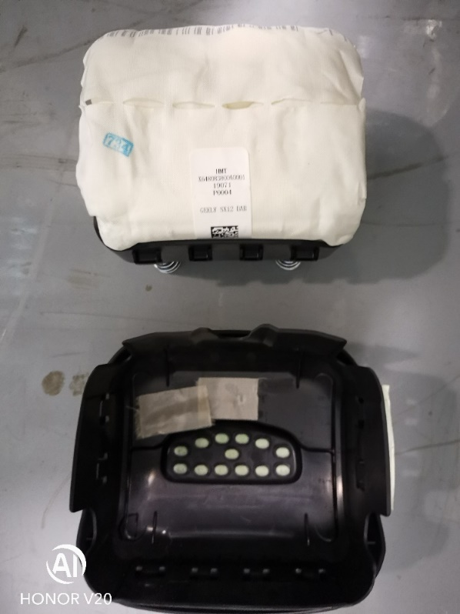
DAB Module – SX12 Housing: PG8 PA6 40% fiber Design type: Floating module

Slide 17


DAB Module – KC-2 Housing: Steel Design type: Floating module

Slide 18
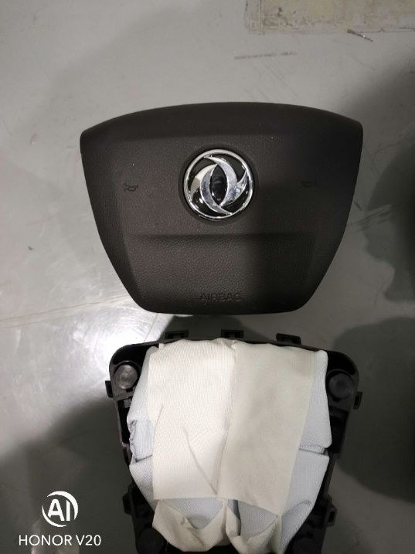

DAB Module – G95 Housing: PG8 PA6 40% fiber Design type: Floating cover

Slide 19
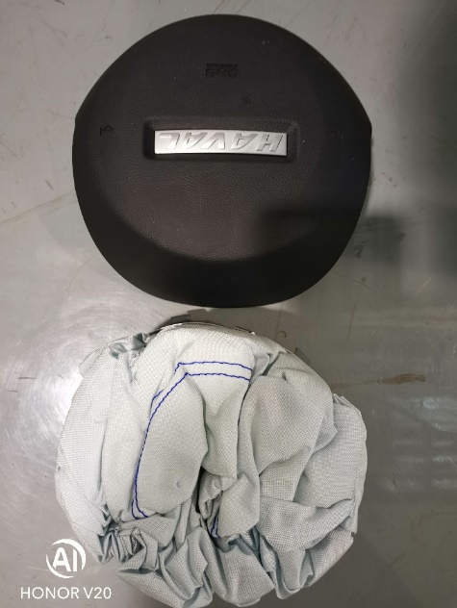
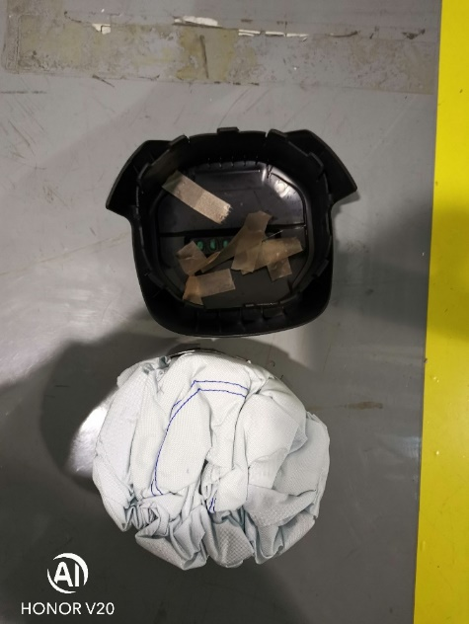
DAB Module – P3011 Housing: Steel Design type: Floating module

Slide 20
Result & analysis -- -35℃
25
27
SX12
KC-2
G95
P3011
18
11
11
11
9
0.5
0.5
KC-2
G95
P3011
SX12

Slide 21
Conclusion The setting temperature is -35℃, but actually the initial temperature is about -30 ℃, and the mean temperature rise range from 26.93 to 0.65 from outer to inner.
 | Mean Initial Temperature/℃ | Mean 2 min. Temperature/℃ | Mean temperature rise/℃
Outer surface | -29.98 | -3.05 | 26.93
Inner surface | -30.49 | -17.73 | 12.77
DAB center | TC: -30.60 | -30.03 | 0.57
 | TR: -33.77 | -33.12 | 0.65
Note：TC-Thermal couple，TR: Thermal Resistance

Slide 22
Result & analysis -- 85℃
0
0
-9
-7
-7
-7.5
-7.5
-23
-21
TC separate from cover
TC separate from cover
SX12
KC-2
G95
P3011
KC-2
G95
P3011
SX12

Slide 23
Conclusion The setting temperature is 85℃, but actually the initial temperature is about 81℃, and the mean temperature decrease range from 26.93 to 0.65 from outer to inner.
 | Mean Initial Temperature/℃ | Mean 2 min. Temperature/℃ | Mean temperature decrease/℃
Outer surface | 81.75 | 59.59 | -22.16
Inner surface | 81.85 | 74.06 | -7.78
DAB center | TC: 81.44 | 54.00 | -10.36
 | TR: 82.51 | 82.24 | -0.273
Note：TC-Thermal couple，TR: Thermal Resistance

Slide 24
Temperature differences source
1
DAB temperature cannot attain its simulation temperature.
2
DAB temperature distribution is not uniform，especially for cover.
3
DAB temperature change rate is influenced by the environment temperature and heat convection.
4
Maybe the volume of DAB chamber and airbag folded type influent the temperature distribution

Slide 25
Test defect
1. The thermal couples are pasted on the surface of DAB, so the inner temperature of cover along the thickness cannot be collected, maybe the temperature change rate is not greater than surface.
2. Maybe the temperature along the tear line change rate is greater because its thickness is less than the DAB average thickness, but the thermal couples cannot pasted in the tear line.
3.Actually, before the DAB deployment test, the DAB module will be transfered mounted on the test equipment in 2 min. So maybe the temperature change rate is greater than this test.

Slide 26
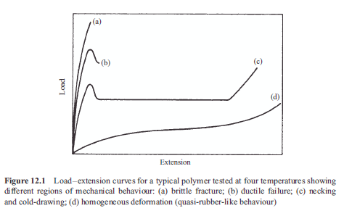
Temperature influence on mechanical property of polymer
(Ref. An Introduction to the Mechanical Properties of Solid Polymers)

Slide 27
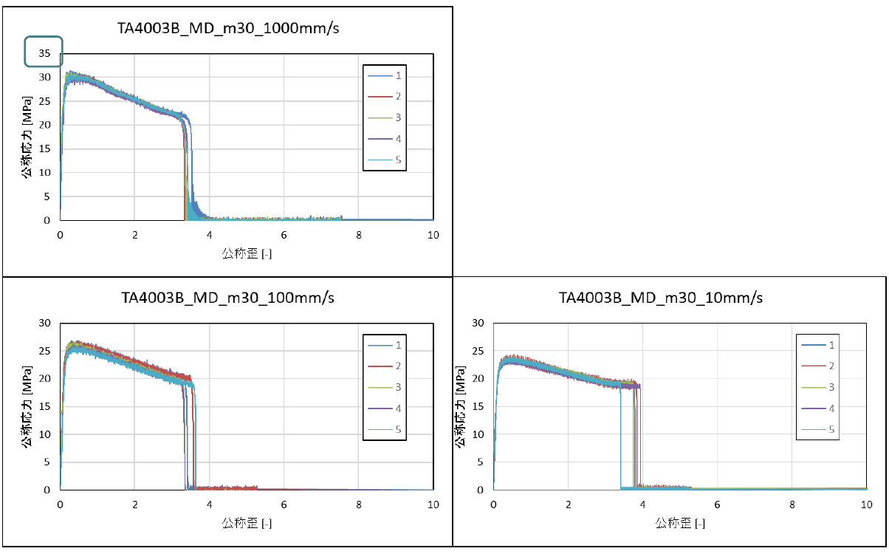
TA4003BE – 30°C
Ductile failure

Slide 28
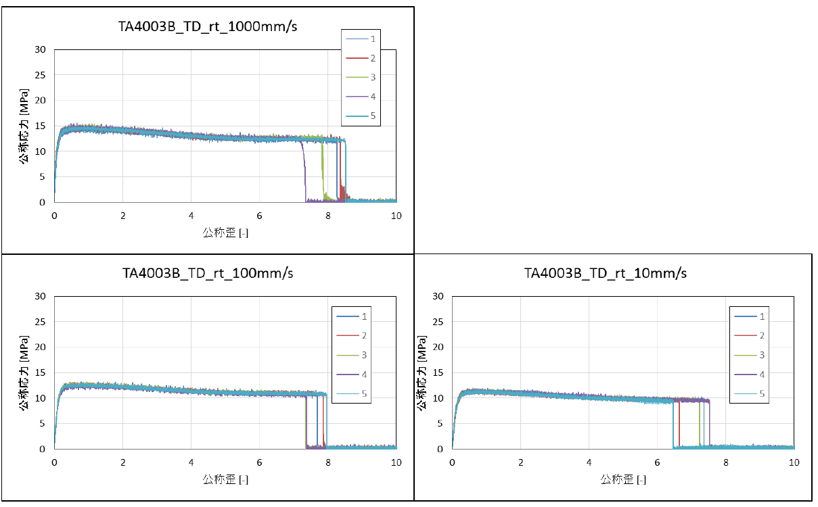
TA4003BE – RT
Necking and cold drawing

Slide 29
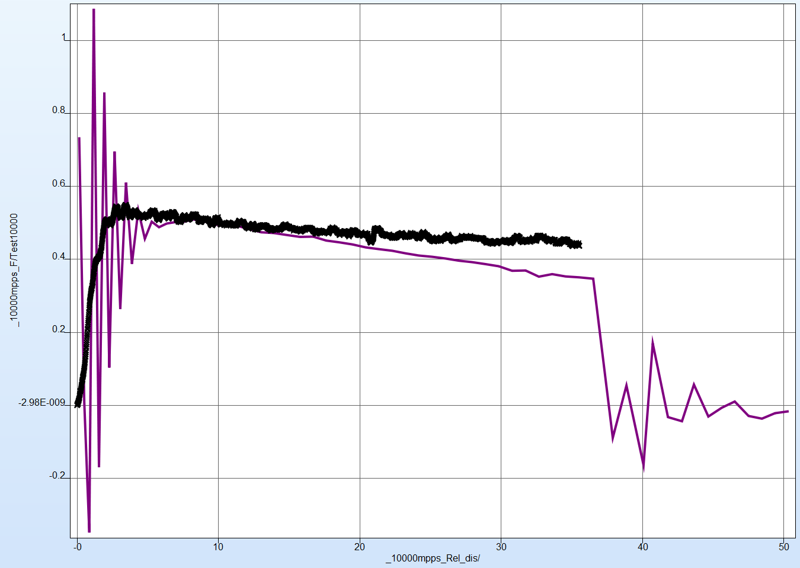
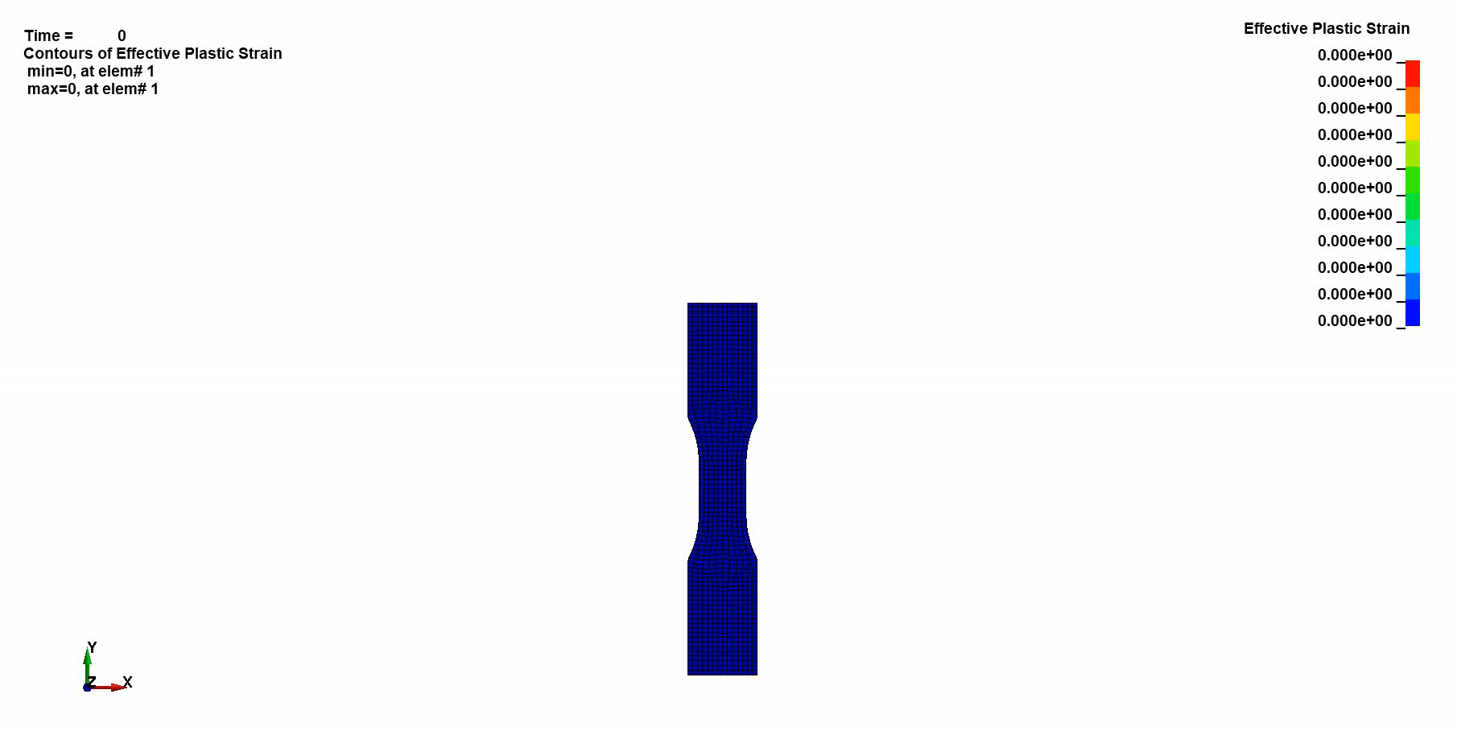
10000mmps

Slide 30
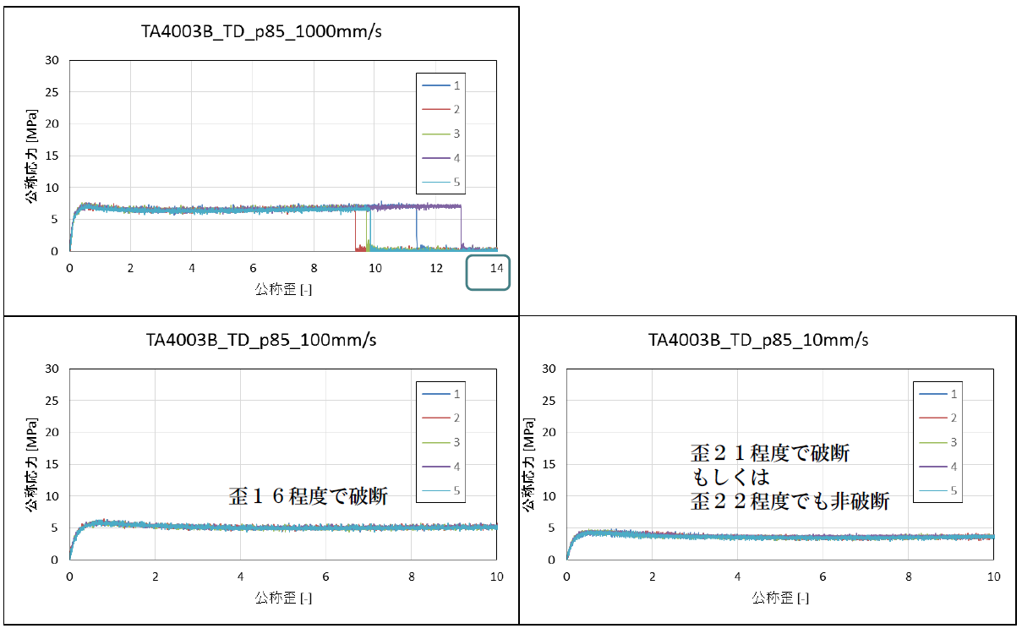
TA4003BE – 85°C
Homogeneous defromation

Slide 31


